Slide 1


Slide 2
Genetic Algorithm

Slide 3
Genetic Algorithm
Genetic Algorithm:
Genetic algorithm (GA) is a search heuristic that mimics يقلد the process of natural selection.
Genetic algorithm generate solutions to optimization problems.

Slide 4
Genetic Algorithm
Initialization
Many individual solutions are (usually) randomly generated to form an initial population.
Selection
During each successive generation, a proportion of the existing population is selected to produce a new generation.
Individual solutions are selected through a fitness-based process, where fitter solutions (as measured by a fitness function) are typically more likely to be selected.

Slide 5
Genetic Algorithm
Example (knapsack problem)
One wants to maximize the total value of objects that can be put in a knapsack of some fixed capacity.
A representation of a solution might be an array of bits, where each bit represents a different object.
the value of the bit (0 or 1) represents whether or not the object is in the knapsack.
The fitness of the solution is the sum of values of all objects in the knapsack if the representation is valid, or 0 otherwise.

Slide 6
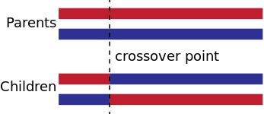
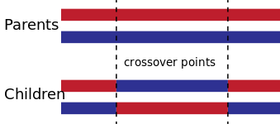
Genetic Algorithm
Crossover (Recombination)
For each new solution to be produced, a pair of "parent" solutions is selected for reproduction from the pool selected previously.
One-point crossover
Two-point crossover

Slide 7
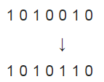
Genetic Algorithm
Mutation
The mutation of bit strings ensue through bit flips at random positions.
Elitism
Allow the best individual(s) from the current generation to carry over to the next, unaltered.

Slide 8

Genetic Algorithm (Matlab)
Global Optimization Toolbox

Slide 9
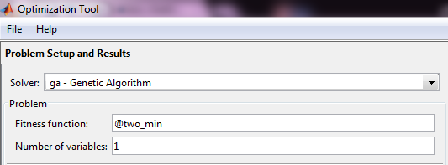

Genetic Algorithm (Matlab)
>> optimtool('ga')

Slide 10
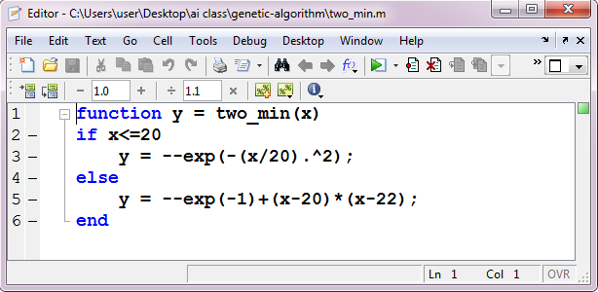
Genetic Algorithm (Matlab)
>> optimtool('ga')

Slide 11
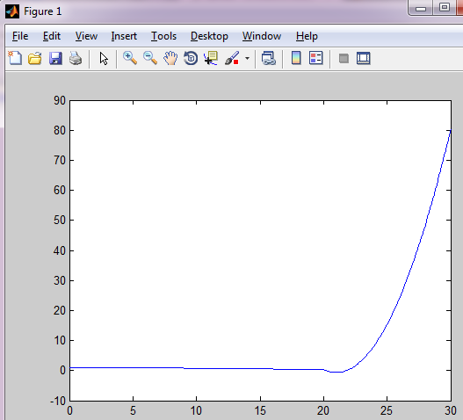
Genetic Algorithm (Matlab)
>> optimtool('ga')
>> test_two_min()

Slide 12
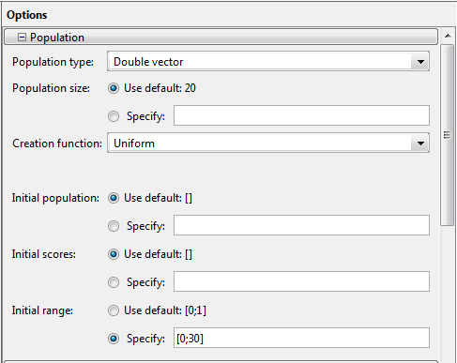
Genetic Algorithm (Matlab)
>> optimtool('ga')

Slide 13

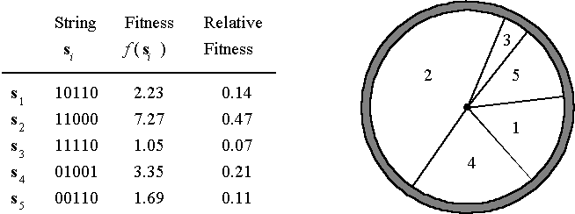
Genetic Algorithm (Matlab)
>> optimtool('ga')

Slide 14
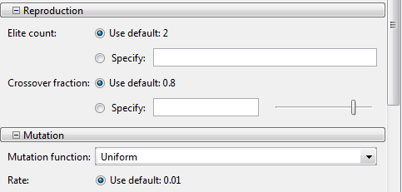
Genetic Algorithm (Matlab)
>> optimtool('ga')

Slide 15

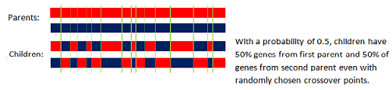
Genetic Algorithm (Matlab)
>> optimtool('ga')
mixing ratio is 0.5

Slide 16
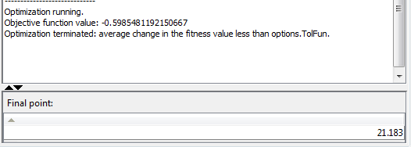
Genetic Algorithm (Matlab)
>> optimtool('ga')

Slide 17

Genetic Algorithm (Matlab)
How to learn more?

Slide 18

Genetic Algorithm (Matlab)
How to learn more?

